Slide 1
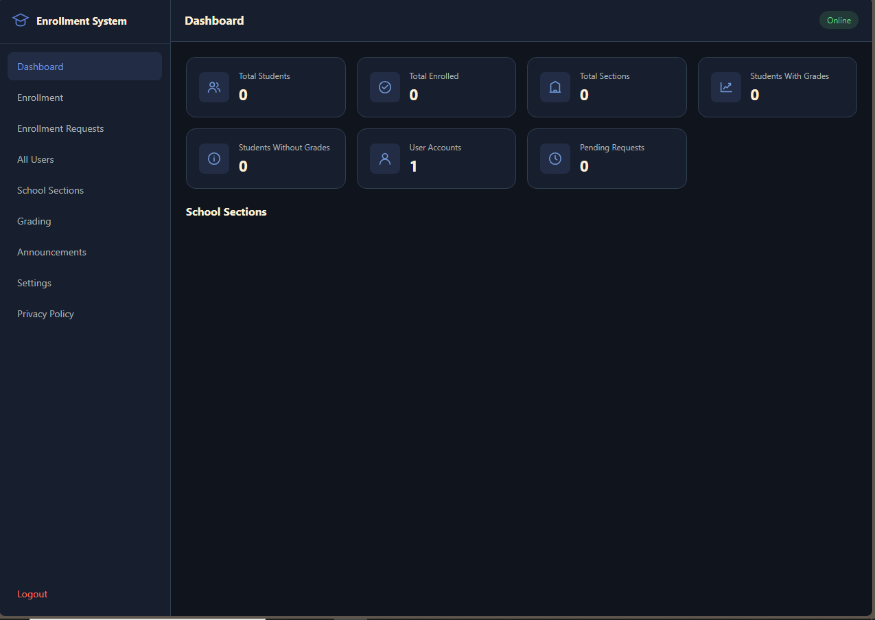
PROJECT PRESENTATION
School Enrollment
and Grading
Management System
A two-role school portal for student enrollment, admin approvals, sections, schedules, and grades
Presented by: Group 6
[Course / Section] | [Instructor] | [Date]
ADMIN DASHBOARD
Notes:
Good day, everyone. We are here to present our School Enrollment and Grading Management System. Students can create accounts and submit enrollment details. Administrators review requests, assign sections, publish schedules, and manage grades. I am [name], together with [group members], from [course and section].

Slide 2
01 / OVERVIEW
One school system, two connected workflows
Students submit enrollment; administrators review and manage school operations.
STUDENT PORTAL
Create an account
Submit an enrollment form
Track approval and assigned section
View section-specific schedule announcements
PRIMARY USER
Students + Administrator / Registrar
SCHOOL ENROLLMENT & GRADING MANAGEMENT SYSTEM
02
Notes:
The system connects a student portal to an administrator dashboard. Students submit information and track their status. The administrator controls review, section assignment, schedule announcements, grading, and settings.

Slide 3
02 / PURPOSE
From manual records to an organized workflow
The project focuses on accuracy, traceability, and simpler administration.
THE PROBLEM
PROJECT OBJECTIVES
Manual records take time.
Information can be hard to track.
Grade entry can introduce errors.
Organize student records
Manage section assignments
Validate grades from 0 to 100
Show useful dashboard statistics
SCHOOL ENROLLMENT & GRADING MANAGEMENT SYSTEM
03
Notes:
Managing student records manually can take time and make information harder to track. Section assignments and grades may become inconsistent when they are kept in separate files. Our objectives were to organize student records, manage sections, validate grades, and provide an administrator dashboard.

Slide 4
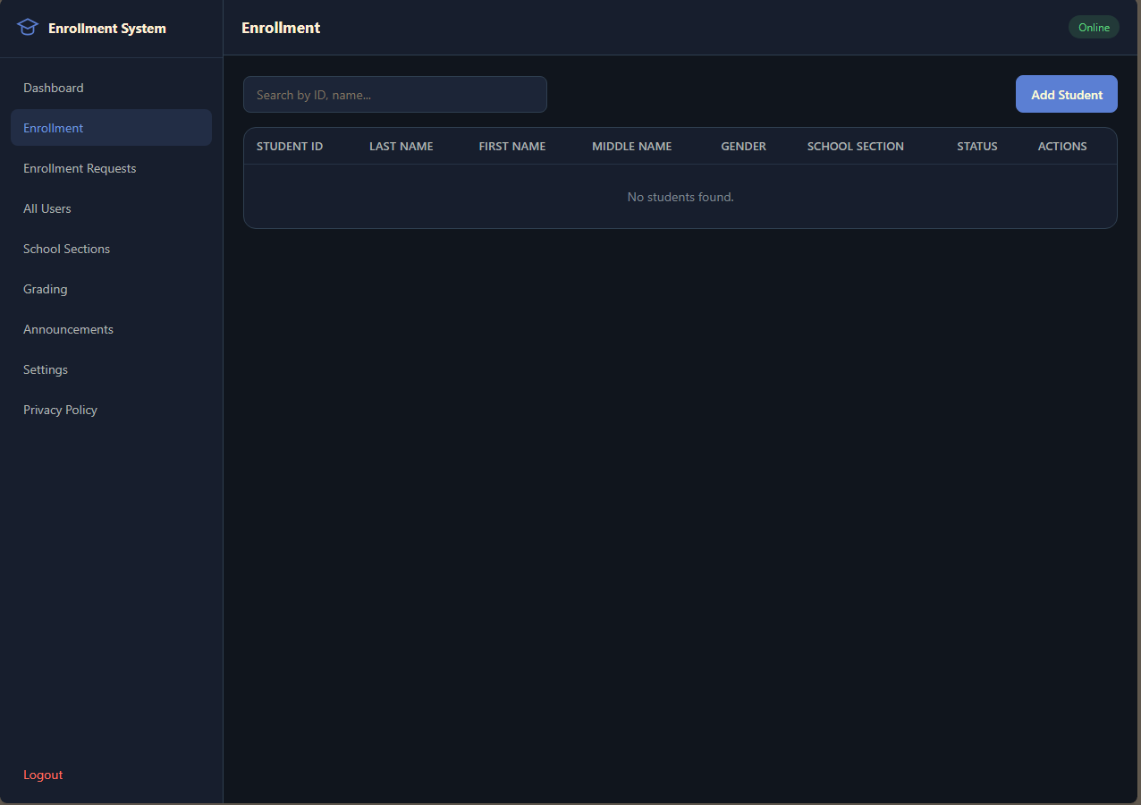
03 / CAPABILITIES
A clear handoff from application to enrollment
Student-submitted records stay pending until an administrator makes the section assignment.
STUDENT
Create account and sign in
Complete enrollment form in a popup
Track pending, approved, or rejected status
See the assigned section and its schedule
ENROLLMENT
SCHOOL ENROLLMENT & GRADING MANAGEMENT SYSTEM
04
Notes:
Students create their own accounts and submit an enrollment form. The administrator reviews the request, assigns a section, manages student records and sections, publishes schedules, enters grades, and updates school settings.

Slide 5
04 / ARCHITECTURE
A simple three-layer architecture
The browser never connects directly to the spreadsheet.
STUDENT + ADMIN
>
WEB FRONT END
>
APPS SCRIPT API
Role-based dashboards
HTML / CSS / JavaScript
Authentication / validation / operations
v
GOOGLE SHEETS DATABASE
Users / Requests / Students / Sections / Grades / Announcements
SCHOOL ENROLLMENT & GRADING MANAGEMENT SYSTEM
05
Notes:
The system has role-specific browser dashboards, an Apps Script API that authenticates and validates each operation, and Google Sheets tables for accounts, enrollment requests, student records, sections, grades, settings, announcements, and activity logs.

Slide 6
05 / DATA
Spreadsheet tables keep records organized
Each sheet has a focused responsibility.
USERS
REQUESTS
STUDENTS
SECTIONS
Student and Admin accounts
Enrollment submissions and review
Approved student details
Grade level and section
GRADES
ANNOUNCEMENTS
SETTINGS
ACTIVITY LOGS
Subject grades and school period
Schedules for assigned sections
School year, subjects, passing grade
Recorded administrative actions
SCHOOL ENROLLMENT & GRADING MANAGEMENT SYSTEM
06
Notes:
The spreadsheet contains separate tables for user accounts, enrollment requests, approved student records, school sections, grades, settings, announcements, and activity logs.

Slide 7
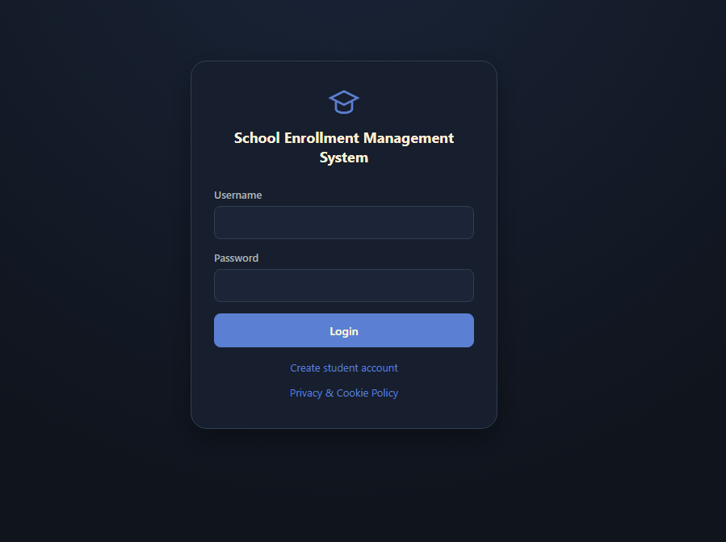
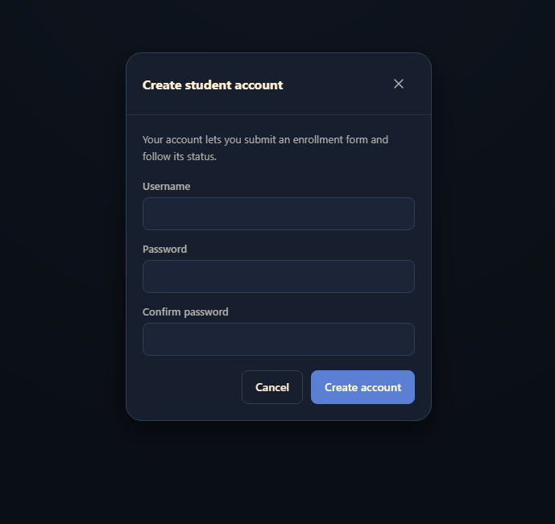
06 / INTERFACE
Sign in or create a student account
One login routes users to the dashboard for their account role.
ROLE-BASED LOGIN
STUDENT SIGNUP
SCHOOL ENROLLMENT & GRADING MANAGEMENT SYSTEM
07
Notes:
The landing page supports both Admin and Student sign-in. Students can create an account using the signup popup, then submit their enrollment details from the Student Portal.

Slide 8
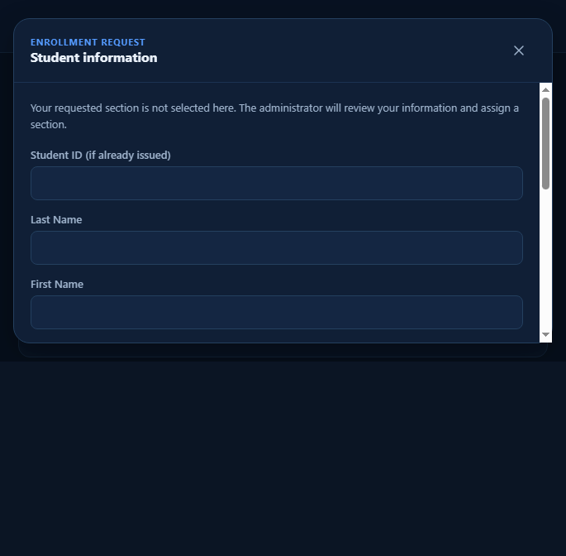
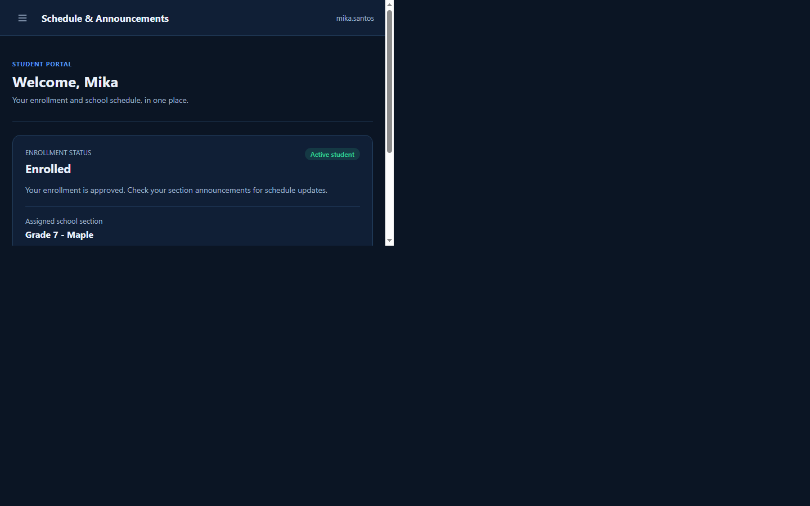
07 / STUDENT PORTAL
Students submit and track enrollment
The student does not assign their own section.
STUDENT SELF-SERVICE
Submit student information in a popup form
See when a request is pending, approved, or rejected
After approval, view the assigned school section
Check schedule announcements for that section
ENROLLMENT FORM
SCHOOL ENROLLMENT & GRADING MANAGEMENT SYSTEM
APPROVED STATUS
08
Notes:
The student creates an account, signs in, and submits a popup enrollment form. The form is sent to an admin review queue. Students can follow the status and see the assigned section once approved.

Slide 9
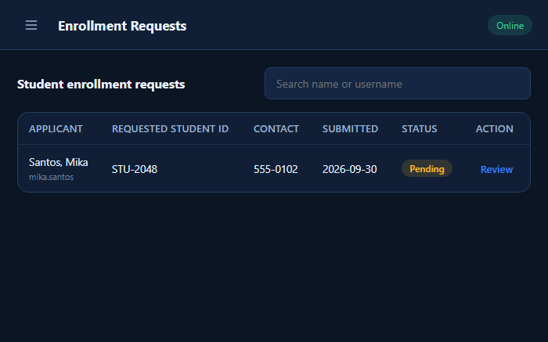
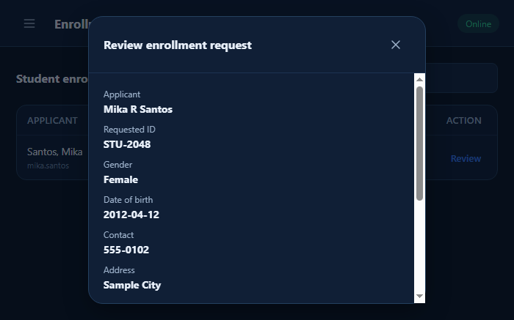
08 / ADMIN REVIEW
The administrator approves and assigns a section
Student requests remain pending until reviewed.
REQUEST QUEUE
REVIEW + ASSIGN
Approval creates the student record and links it to the account.
SCHOOL ENROLLMENT & GRADING MANAGEMENT SYSTEM
09
Notes:
The administrator searches the request queue, reviews the submitted information, and either rejects or approves. Approval requires an active section assignment before the student record is created.

Slide 10
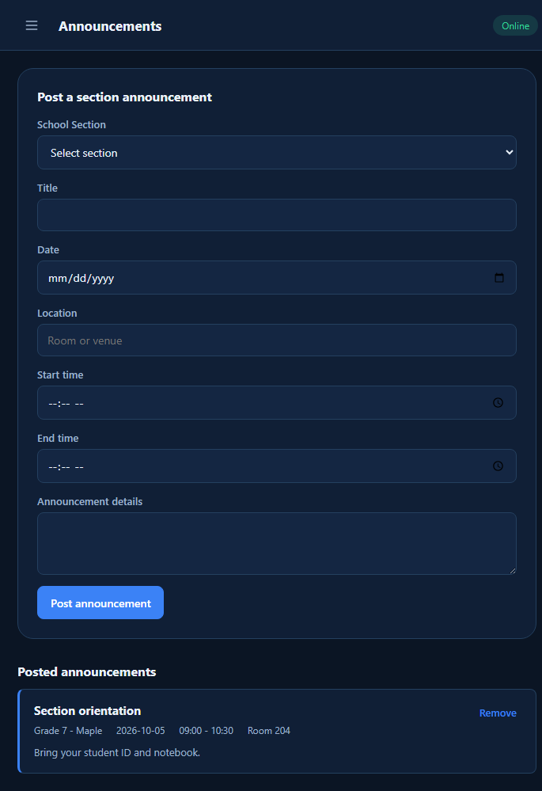
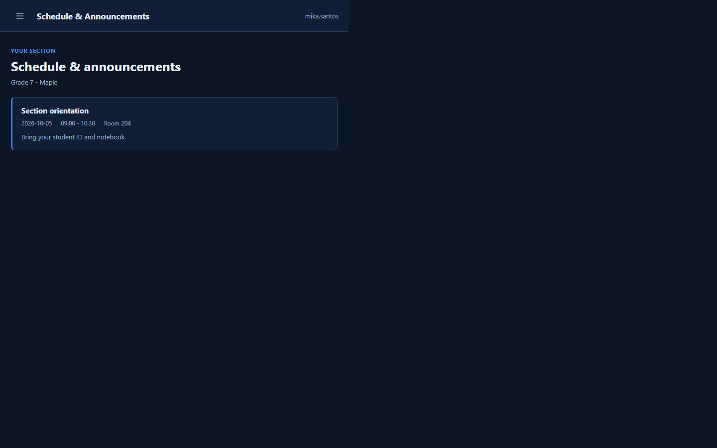
09 / SCHEDULES
Announcements are targeted to a school section
Students only receive the schedule for their assigned section.
ADMIN POSTS
STUDENT VIEW
SCHOOL ENROLLMENT & GRADING MANAGEMENT SYSTEM
10
Notes:
Administrators create a dated schedule announcement for one section. The student dashboard shows only announcements matching the approved student section. Section management shows an SVG loading indicator during save/archive, and Admin logout has a custom confirmation dialog.

Slide 11
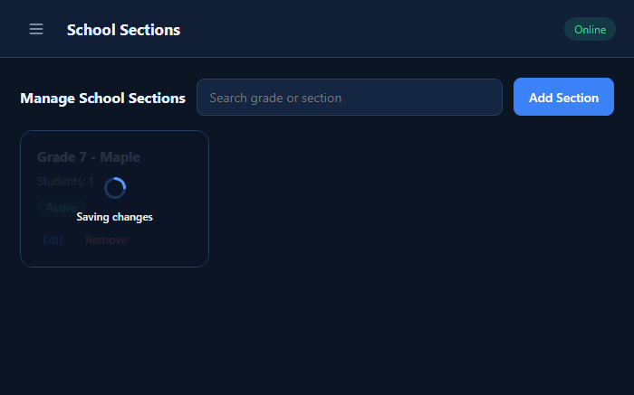
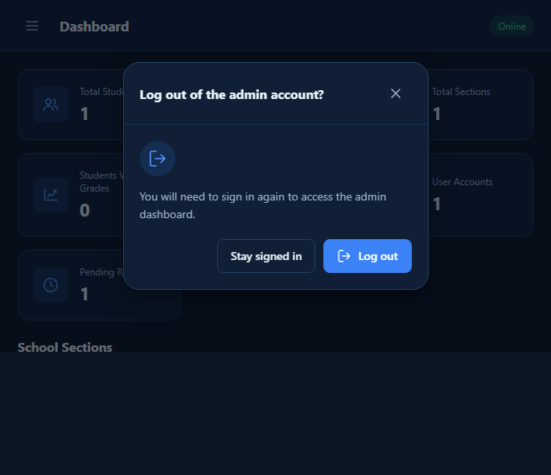
10 / INTERACTION
Clear feedback during important actions
Section updates show progress; Admin logout asks for confirmation.
SECTION LOADING
LOGOUT CONFIRMATION
SCHOOL ENROLLMENT & GRADING MANAGEMENT SYSTEM
11
Notes:
The section card displays an SVG loading indicator and disables its actions while the server updates it. Admin logout uses a custom confirmation popup with a loading state after confirmation.

Slide 12
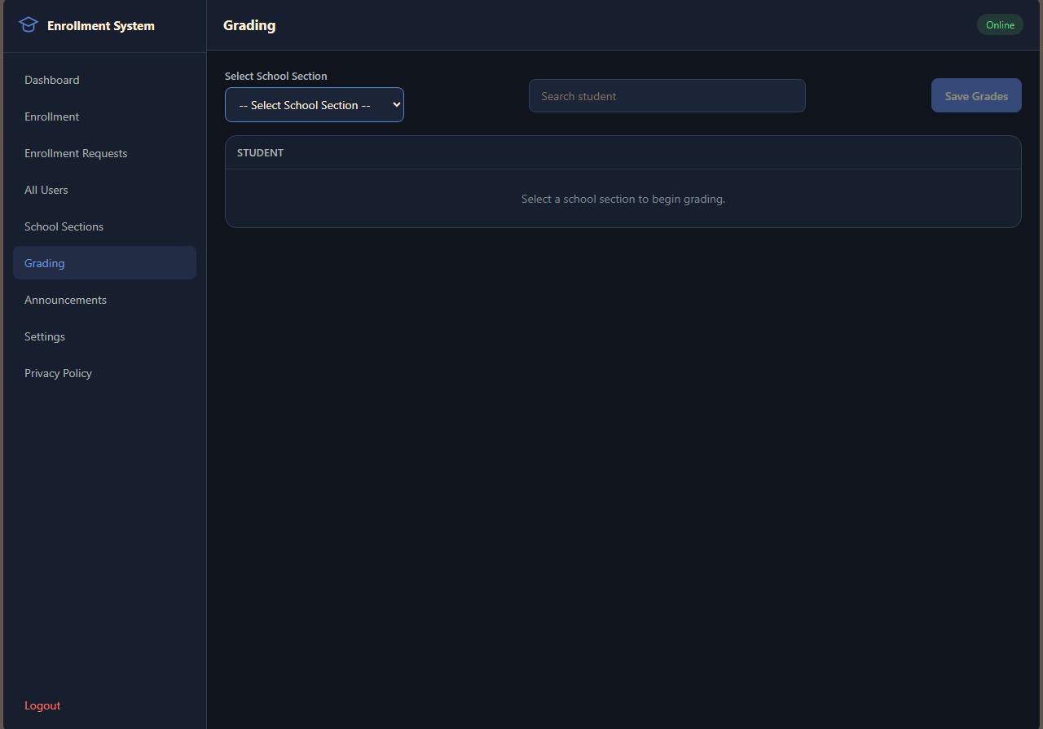
11 / DEMONSTRATION
A complete student-to-admin workflow
Show the handoff from enrollment form to approved section schedule.
01
SIGN UP
02
SUBMIT
03
REVIEW
04
ANNOUNCE
Student creates account
Complete enrollment form
Admin assigns section
Publish section schedule
Student signup > Enrollment request > Admin review > Section assignment > Section announcement
SCHOOL ENROLLMENT & GRADING MANAGEMENT SYSTEM
12
Notes:
Demonstrate the student-to-admin workflow, then show the admin grading page. The Admin signs in, reviews enrollment submissions, assigns a section, announces its schedule, and can separately manage grades and settings.

Slide 13
12 / ENGINEERING
Access and data flow have clear ownership
Validation and feedback are handled at both browser and API boundaries.
CHALLENGE
SOLUTION
Duplicate student records
Validate Student ID before saving
Invalid grade values
Enforce the 0 to 100 grade range
Role separation
Backend restricts Admin and Student actions
Section deletion risk
Archive sections with students or grades
Wrong-section schedules
Filter announcements by approved section
Slow write responses
Reconcile writes with authoritative snapshots
SCHOOL ENROLLMENT & GRADING MANAGEMENT SYSTEM
13
Notes:
The system validates student and grade input, enforces account roles in the backend, archives sections that still have records, targets schedule announcements to a section, and gives a clear response when a write reply is delayed.

Slide 14
13 / CONCLUSION
Enrollment moves from
submission to school-ready.
FUTURE
IMPROVEMENTS
Printable reports
Data export and backup
Notifications
Teacher portal
Student self-service with Admin review
Section assignment and targeted schedule announcements
Built with HTML, JavaScript, Apps Script, and Google Sheets
THANK YOU
Questions?
Notes:
To conclude, our system provides a guided path from student enrollment submission to administrator approval, section assignment, schedule announcements, and grading. Future improvements could include printable reports, data export, backups, notifications, and a teacher portal. Thank you. We are ready for questions.

